Slide 1
A Mobile Information Kiosk of Buildings for Visitors with navigation using AR
Supervisor Li Tak Sing
Student ID 11658374
Student Chan Kwok Chi

Slide 2
Problem

Slide 3
Problem in real life
Indoor environment of modern buildings is complicated
People find difficult in exploring an unfamiliar building
- Don’t know the location of services, like ATM
- Don’t know what promotion actives are taking
place

Slide 4
Problem analysis
People cannot gain information in need when they are exploring an unfamiliar building

Slide 5
Project Aims
Provide navigation as well as information service to visitors.
Use AR to provide user friendly interface.

Slide 6
Existing Solutions
Several works have been done by researchers:
Some works like [1] use AR to provide indoor navigation. But they do not work much on information system.
Some works like [2] already can provide advertisement and navigation in supermarket. But they do not cover other indoor environment.
Thus there is still a gap between real life requirements and modern technologies.

Slide 7
Methodology

Slide 8

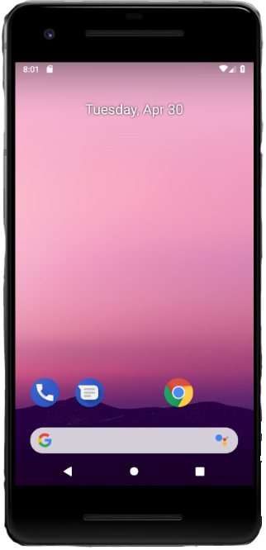
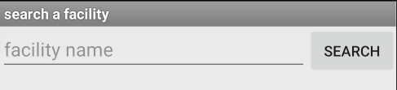
Expected inputs and outputs
Navigation guidance
Activities or other information

Slide 9
Technical Challenges
Information presentation
- in AR style
Object recognition
- recognize the image inputs
Navigation
- keep track of users’ orientation and position

Slide 10
Techniques Employed
ARCore
- combine virtual object with live captures
- keep track of users’ motion and orientation
AI
- to recognize objects in image
Web page and database techniques
- provide a information management entry for
building managers

Slide 11
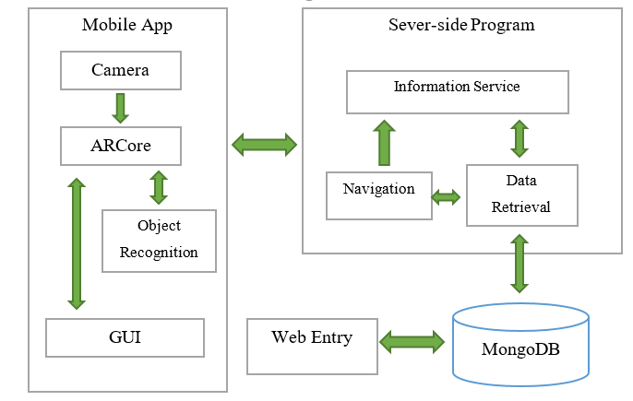
System design – whole design

Slide 12
Demo before going deeper

Slide 13
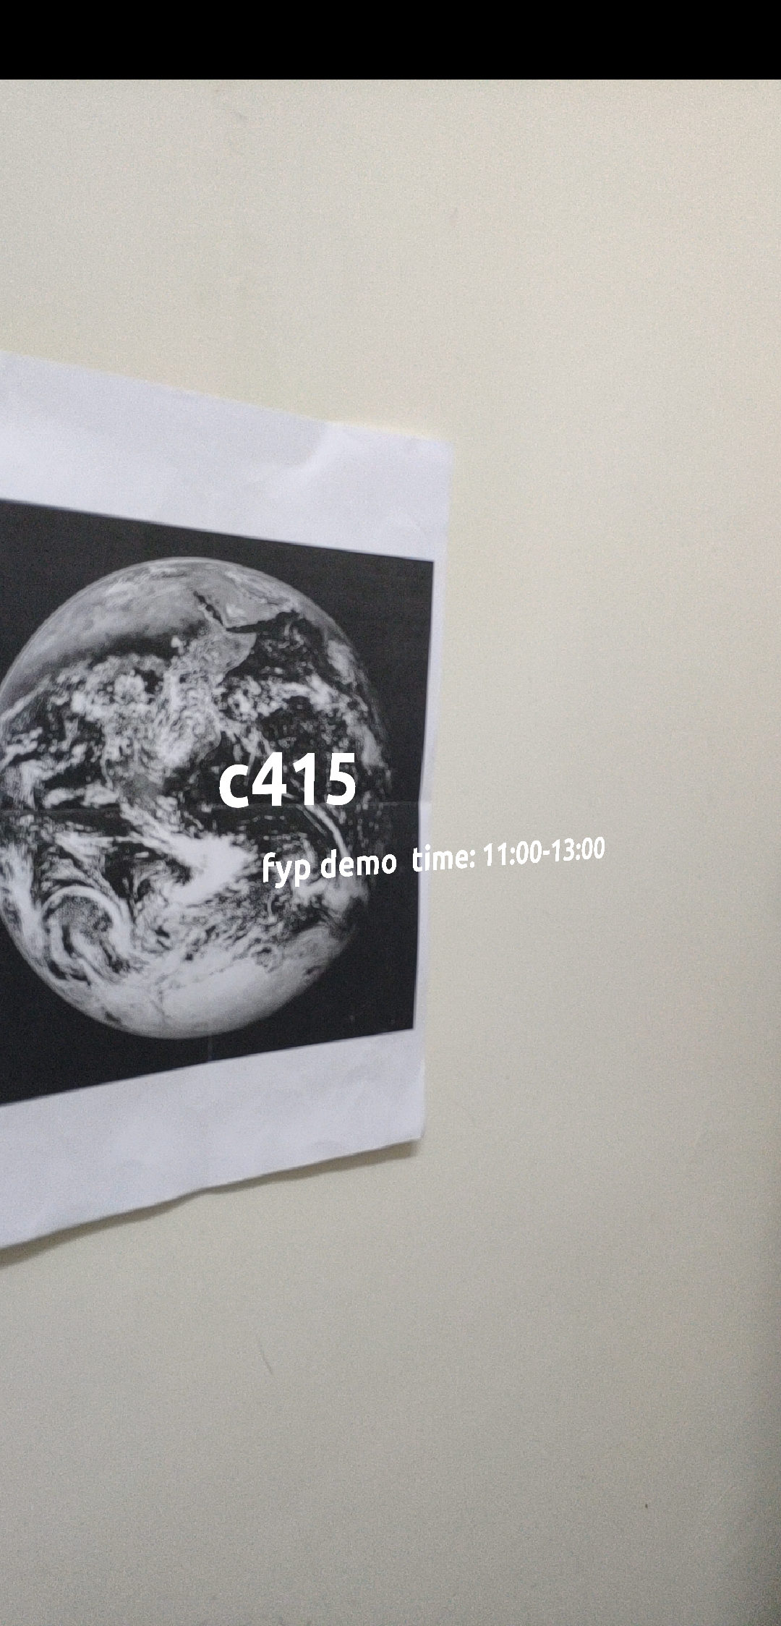
System design – Information service
Set up markers
- post or QR codes
User scans those markers, information will be displayed
If these markers are small, it is hard to
contribute to navigation function

Slide 14
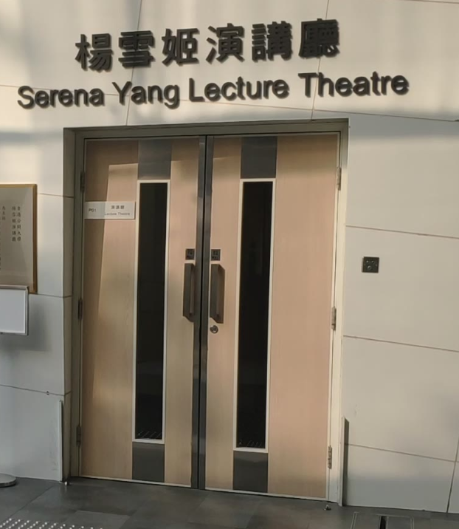
System design – navigation (1)
Set up static objects for reference
- flat objects, like doors, logos
- record coordinates of those objects
Set user’s initial orientation
- magnetic sensor doesn’t work well
- assume user is facing against the object
90°
user
object
Vertical view

Slide 15
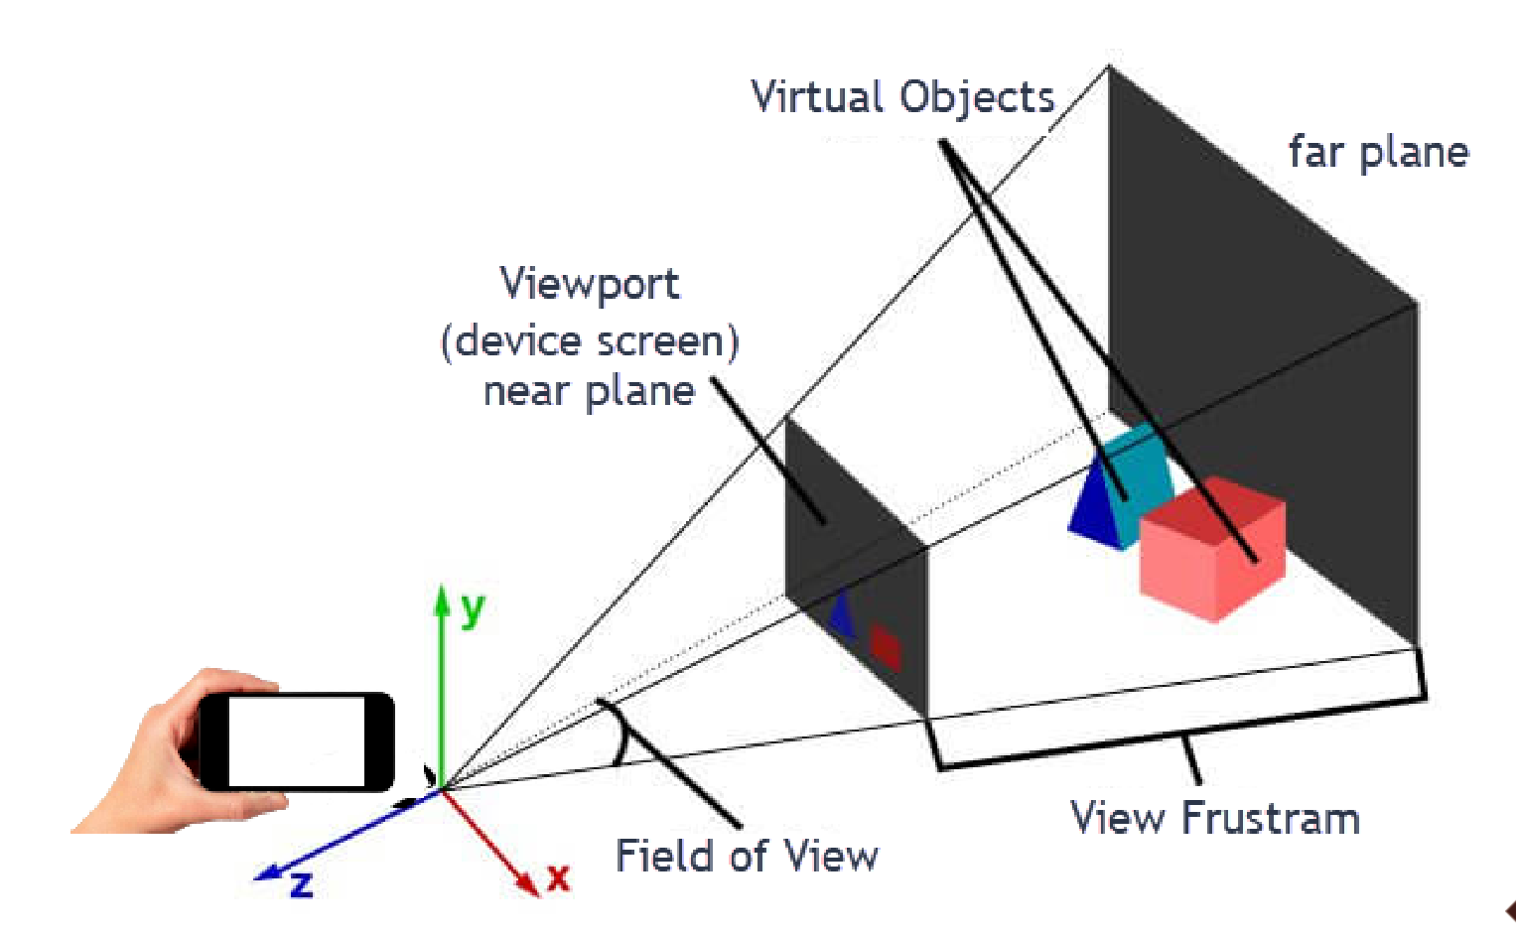

System design – navigation (2)
Estimate distance between user and referencing objects
$$\frac{f}{l}=\frac{D}{L}$$

Slide 16
System design – navigation (3)
Use AI program to recognize real objects
- AI program can mark up the object position on
screen with a rectangle
- Use the height of the rectangle for distance
calculation

Slide 17
System design – navigation (4)
Use ARCore to keep track of user’s rotation and motion
- current orientation can be obtained according to
initial orientation
- current user position can also be calculated
according to initial coordinates

Slide 18
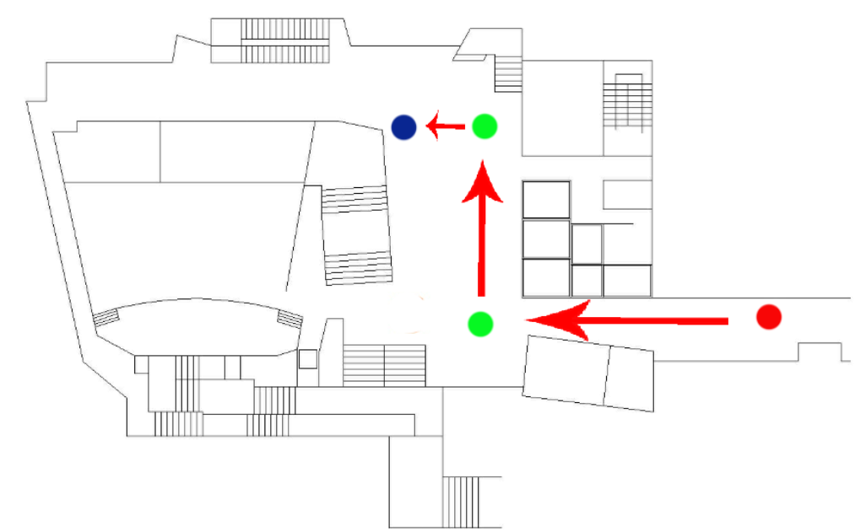
System design – navigation (5)
Set up hidden nodes
- included into path
- Change arrow direction a node is reached

Slide 19
Evaluation – Accuracy of AI model

Slide 20
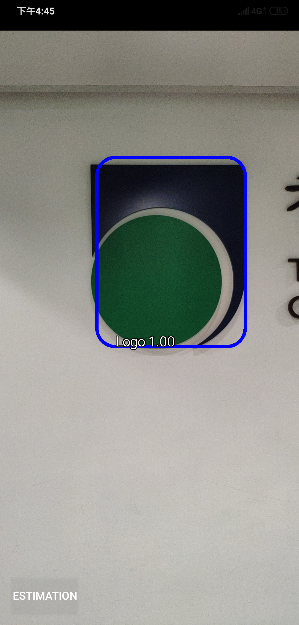
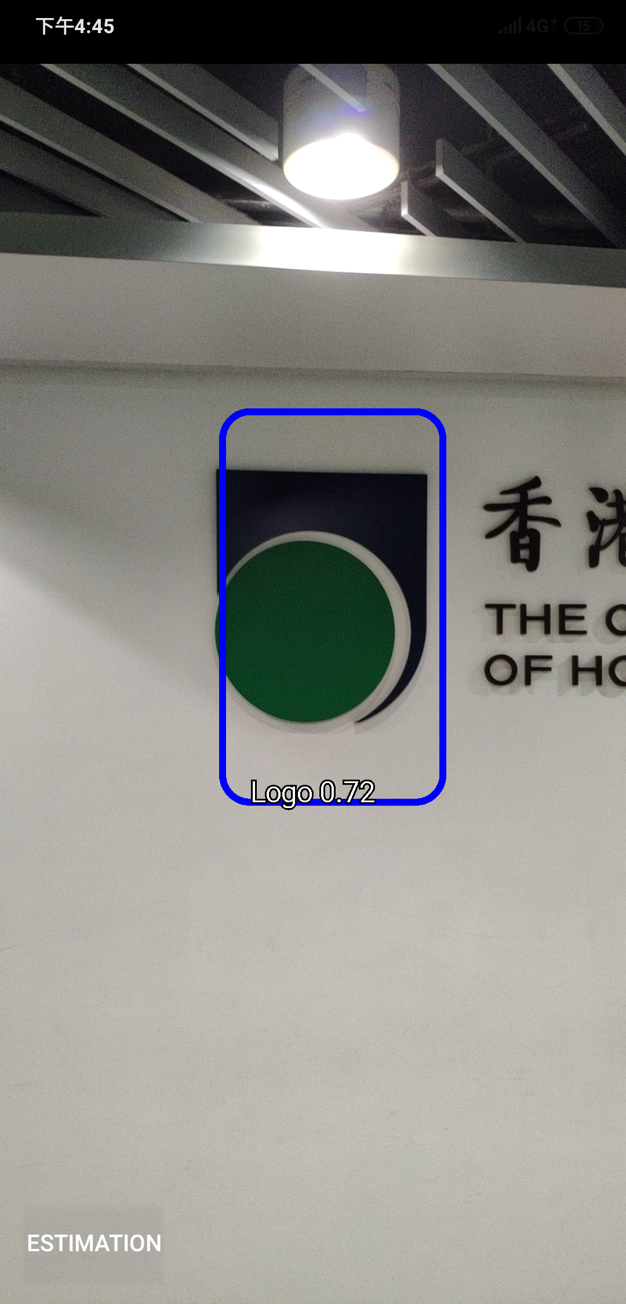
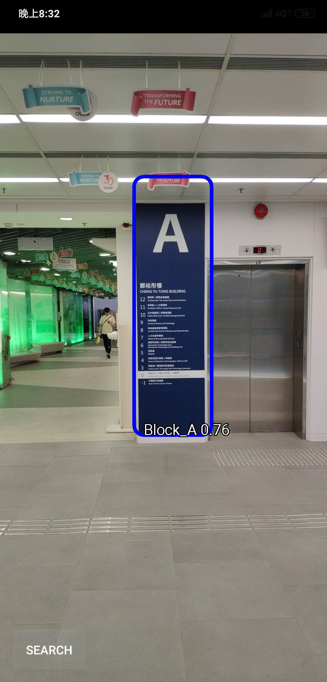
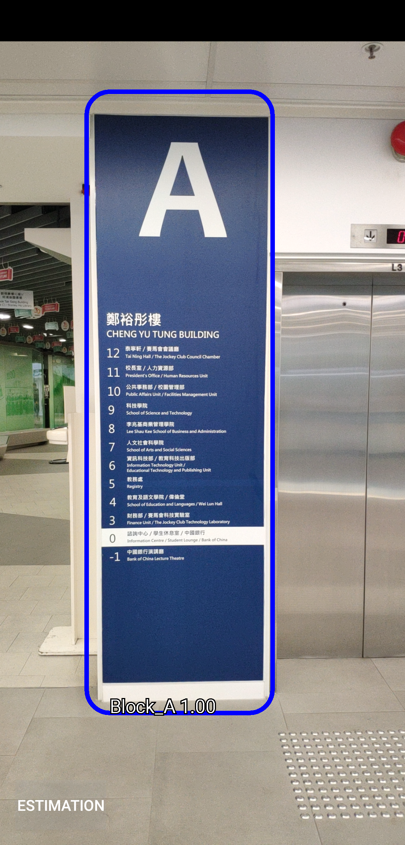
Evaluation – Accuracy of detection box

Slide 21
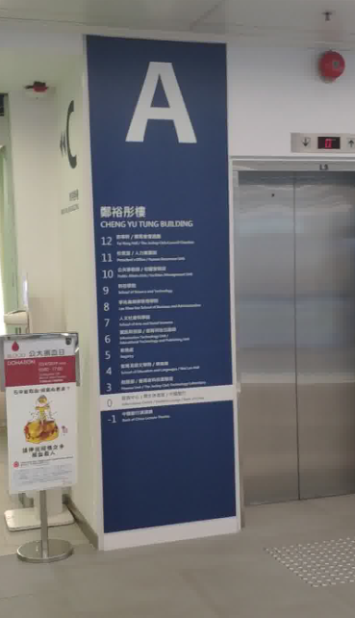
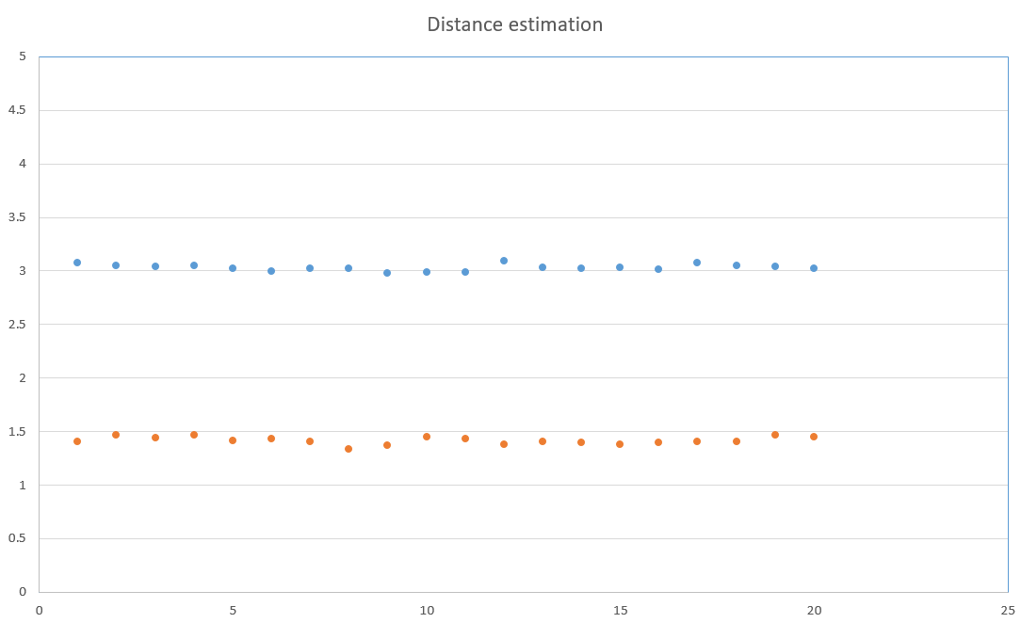

Evaluation – Accuracy of distance estimation

Slide 22
Future Works
Need more data or better hyper parameters for model training
Other algorithm can help to improve the orientation estimation
5G may bring lot of changes

Slide 23
References
[1] M. Neges, C. Koch, M. König, and M. Abramovici, “Combining visual natural markers and IMU for improved AR based indoor navigation,” Advanced Engineering Informatics, vol. 31, pp. 18–31, 2017.
[2] Zhu, Wei, Charles B. Owen, Hairong Li, and Joo-Hyun Lee. "Personalized in-store e-commerce with the promopad: an augmented reality shopping assistant." Electronic Journal for E-commerce Tools and Applications 1, no. 3, pp. 1-19, 2004

Slide 24
Thank You

